Slide 1
Multiplexer and Demultiplexer
Dr. Manju Khurana
Assistant Professor, CSED
TIET, Patiala
manju.khurana@thapar.edu

Slide 2
Multiplexer
A multiplexer is a combinational circuit that has 2^{n} input lines and a single output line. Simply, the multiplexer is a multi-input and single-output combinational circuit. The binary information is received from the input lines and directed to the output line. On the basis of the values of the selection lines, one of these data inputs will be connected to the output.
Unlike encoder and decoder, there are n selection lines and 2^{n} input lines. So, there is a total of 2^{N} possible combinations of inputs. A multiplexer is also treated as Mux.
There are various types of the multiplexer which are as follows:
2×1 Multiplexer
4×1 Multiplexer
8 to 1 Multiplexer
16 to 1 Multiplexer

Slide 3
2×1 Multiplexer
In 2×1 multiplexer, there are only two inputs, i.e., A₀ and A₁, 1 selection line, i.e., S₀ and single outputs, i.e., Y. On the basis of the combination of inputs which are present at the selection line S₀, one of these 2 inputs will be connected to the output.

Slide 4
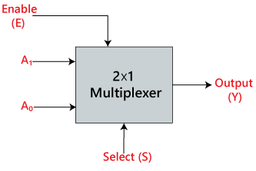
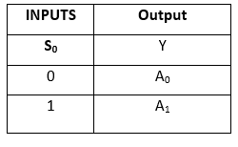
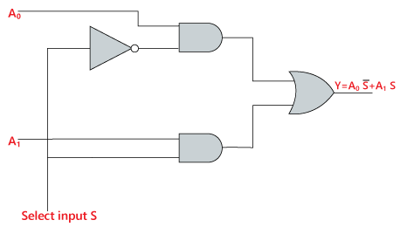
2×1 Multiplexer
Block Diagram:
Truth Table:
Logical circuit:
The logical expression of the term Y is as follows:
Y=S₀'.A₀ + S₀.A₁

Slide 5
4×1 Multiplexer
In the 4×1 multiplexer, there is a total of four inputs, i.e., A₀, A₁, A₂, and A₃, 2 selection lines, i.e., S₀ and S₁ and single output, i.e., Y. On the basis of the combination of inputs that are present at the selection lines S₀ and S₁, one of these 4 inputs are connected to the output.

Slide 6
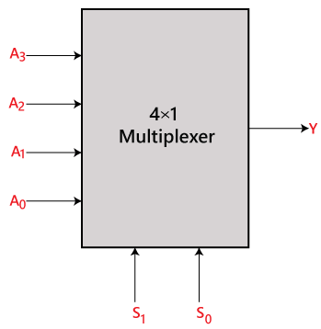
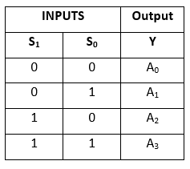
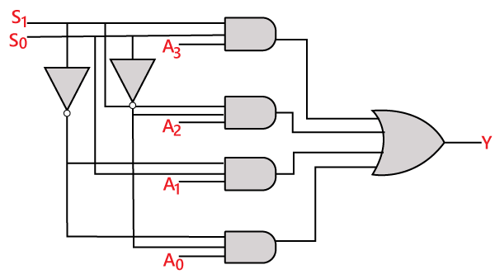
4×1 Multiplexer
Block Diagram:
Truth Table:
Logical circuit:
The logical expression of the term Y is as follows:
Y=S₁' S₀' A₀ + S₁' S₀ A₁ + S₁ S₀' A₂ + S₁ S₀ A₃

Slide 7
8×1 Multiplexer
In the 8 to 1 multiplexer, there are total eight inputs, i.e., A₀, A₁, A₂, A₃, A₄, A₅, A₆, and A₇, 3 selection lines, i.e., S₀, S₁and S₂ and single output, i.e., Y. On the basis of the combination of inputs that are present at the selection lines S₀, S₁, and S₂, one of these 8 inputs are connected to the output.

Slide 8
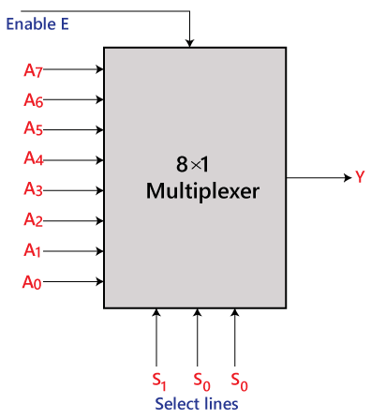
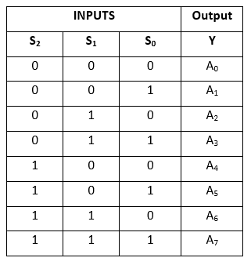
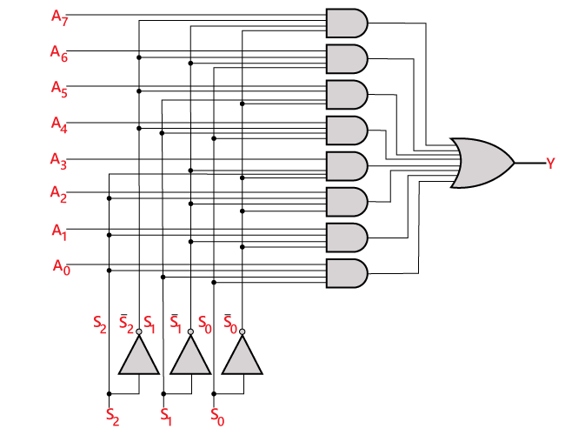
8×1 Multiplexer
Block Diagram:
Truth Table:
Logical circuit:
The logical expression of the term Y is as follows:
Y=S₀'.S₁'.S₂'.A₀ + S₀.S₁'.S₂'.A₁ + S₀'.S₁.S₂'.A₂ + S₀.S₁.S₂'.A₃ + S₀'.S₁'.S₂ A₄ + S₀.S₁'.S₂ A₅ + S₀'.S₁.S₂ .A₆ + S₀.S₁.S₃.A₇

Slide 9
8×1 Multiplexer using 4×1 and 2×1 multiplexer
We can implement the 8×1 multiplexer using a lower order multiplexer. To implement the 8×1 multiplexer, we need two 4×1 multiplexers and one 2×1 multiplexer. The 4×1 multiplexer has 2 selection lines, 4 inputs, and 1 output. The 2×1 multiplexer has only 1 selection line.
For getting 8 data inputs, we need two 4×1 multiplexers. The 4×1 multiplexer produces one output. So, in order to get the final output, we need a 2×1 multiplexer.

Slide 10
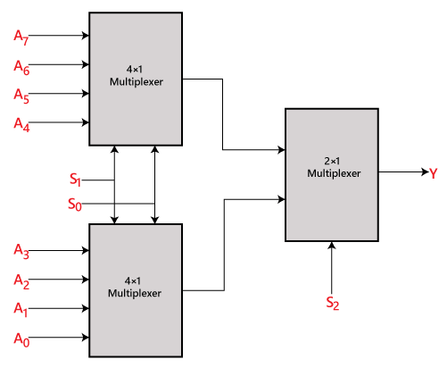
8×1 Multiplexer using 4×1 and 2×1 multiplexer
Block Diagram:

Slide 11
16×1 Multiplexer
In the 16 to 1 multiplexer, there are total of 16 inputs, i.e., A₀, A₁, …, A₁₆, 4 selection lines, i.e., S₀, S₁, S₂, and S₃ and single output, i.e., Y. On the basis of the combination of inputs that are present at the selection lines S₀, S₁, and S₂, one of these 16 inputs will be connected to the output.

Slide 12
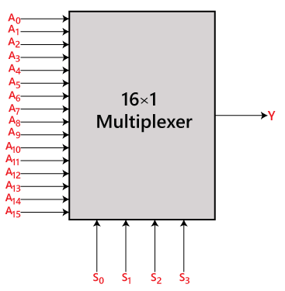
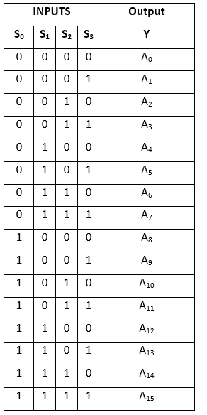
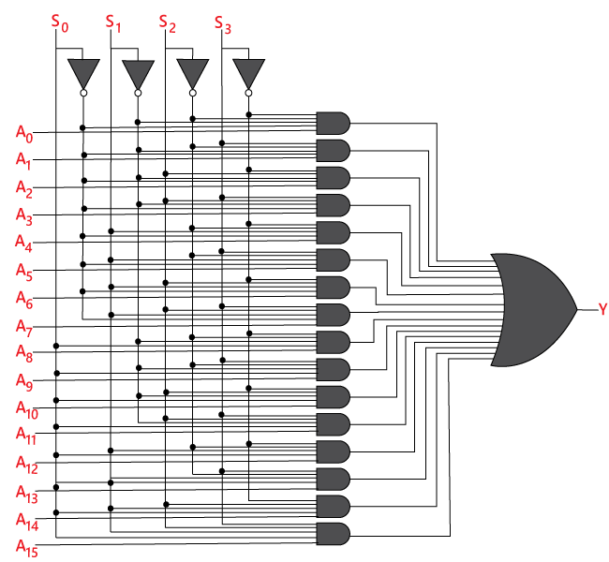
16×1 Multiplexer
Block Diagram:
Truth Table:
Logical circuit:
The logical expression of the term Y is as follows:
Y=A₀.S₀'.S₁'.S₂'.S₃‘ + A₁.S₀'.S₁'.S₂ '.S₃ + A₂.S₀'.S₁'.S₂.S₃‘ + A₃.S₀'.S₁ '.S₂.S₃ + A₄.S₀'.S₁.S₂'.S₃‘ + A₅.S₀'.S₁.S₂'.S₃ + A₆.S₁.S₂.S₃‘ + A₇.S₀'.S₁.S₂.S₃ + A₈.S₀.S₁'.S₂'.S₃‘ + A₉.S₀.S₁'.S₂'.S₃ + Y₁0.S₀.S₁'.S₂.S₃ ‘ + A₁1.S₀.S₁'.S₂.S₃ + A₁2 S₀.S₁.S₂ '.S₃‘ + A₁3.S₀.S₁.S₂'.S₃ + A₁4.S₀.S₁ .S₂.S₃‘ + A₁5.S₀.S₁.S₂'.S₃

Slide 13
16×1 Multiplexer using 8×1 and 2×1 multiplexer
We can implement the 16×1 multiplexer using a lower order multiplexer. To implement the 8×1 multiplexer, we need two 8×1 multiplexers and one 2×1 multiplexer. The 8×1 multiplexer has 3 selection lines, 4 inputs, and 1 output. The 2×1 multiplexer has only 1 selection line.
For getting 16 data inputs, we need two 8 ×1 multiplexers. The 8×1 multiplexer produces one output. So, in order to get the final output, we need a 2×1 multiplexer.

Slide 14
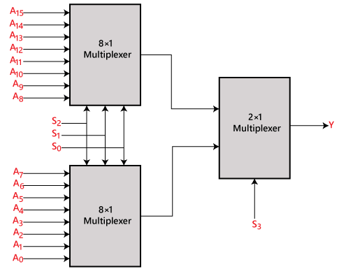
16×1 Multiplexer using 8×1 and 2×1 multiplexer
Block Diagram:

Slide 15
De-multiplexer
A De-multiplexer is a combinational circuit that has only 1 input line and 2^{N} output lines. Simply, the multiplexer is a single-input and multi-output combinational circuit. The information is received from the single input lines and directed to the output line. On the basis of the values of the selection lines, the input will be connected to one of these outputs. De-multiplexer is opposite to the multiplexer.
Unlike encoder and decoder, there are n selection lines and 2^{n} outputs. So, there is a total of 2^{n} possible combinations of inputs. De-multiplexer is also treated as De-mux.
There are various types of the De-multiplexer which are as follows:
1×2 De-multiplexer
1×4 De-multiplexer
1×8 De-multiplexer
1×16 De-multiplexer

Slide 16
1×2 De-multiplexer
In the 1 to 2 De-multiplexer, there are only two outputs, i.e., Y₀, and Y₁, 1 selection lines, i.e., S₀, and single input, i.e., A. On the basis of the selection value, the input will be connected to one of the outputs.

Slide 17
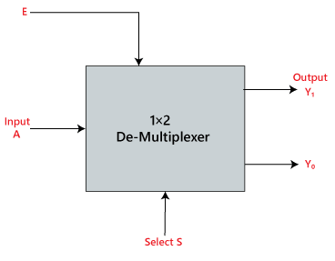
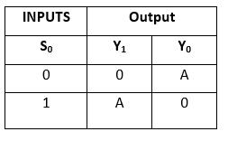
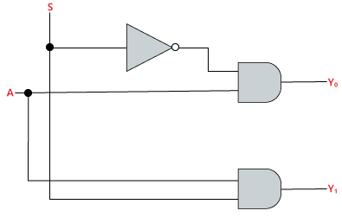
1×2 De-multiplexer
Block Diagram:
Truth Table:
Logical circuit:
The logical expression of the term Y is as follows:
Y₀=S₀'.A Y₁=S₀.A

Slide 18
1×4 De-multiplexer
In 1 to 4 De-multiplexer, there are total of four outputs, i.e., Y₀, Y₁, Y₂, and Y₃, 2 selection lines, i.e., S₀ and S₁ and single input, i.e., A. On the basis of the combination of inputs which are present at the selection lines S₀ and S₁, the input be connected to one of the outputs.

Slide 19
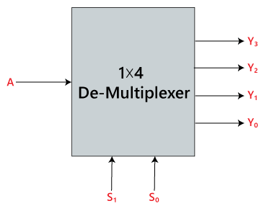
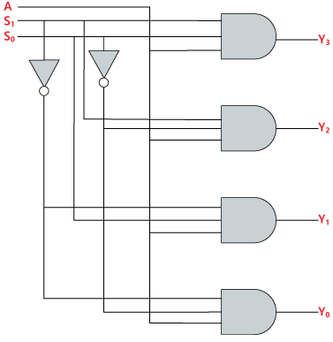
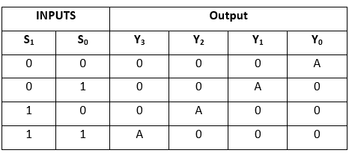
1×4 De-multiplexer
Block Diagram:
Truth Table:
Logical circuit:
The logical expression of the term Y is as follows:
Y₀=S₁' S₀' A y₁=S₁' S₀ A y₂=S₁ S₀' A y₃=S₁ S₀ A

Slide 20
1×8 De-multiplexer
In 1 to 8 De-multiplexer, there are total of eight outputs, i.e., Y₀, Y₁, Y₂, Y₃, Y₄, Y₅, Y₆, and Y₇, 3 selection lines, i.e., S₀, S₁and S₂ and single input, i.e., A. On the basis of the combination of inputs which are present at the selection lines S₀, S₁ and S₂, the input will be connected to one of these outputs.

Slide 21
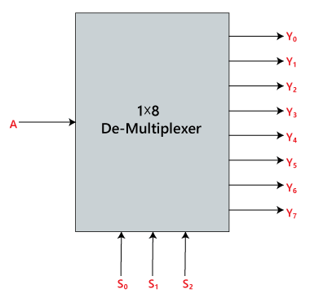
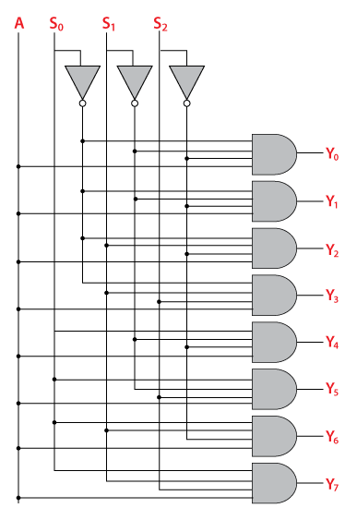
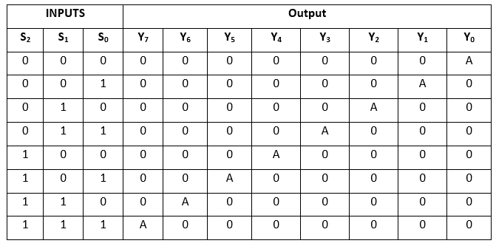
1×8 De-multiplexer
Block Diagram:
Truth Table:
Logical circuit:
The logical expression of the term Y is as follows:
Y₀=S₀'.S₁'.S₂'.A Y₁=S₀.S₁'.S₂'.A Y₂=S₀'.S₁.S₂'.A Y₃=S₀.S₁.S₂'.A Y₄=S₀'.S₁'.S₂ A Y₅=S₀.S₁'.S₂ A Y₆=S₀'.S₁.S₂ A Y₇=S₀.S₁.S₃.A

Slide 22
1×8 De-multiplexer using 1×4 and 1×2 De-multiplexer
We can implement the 1×8 de-multiplexer using a lower order de-multiplexer. To implement the 1×8 de-multiplexer, we need two 1×4 de-multiplexer and one 1×2 de-multiplexer. The 1×4 multiplexer has 2 selection lines, 4 outputs, and 1 input. The 1×2 de-multiplexer has only 1 selection line.
For getting 8 data outputs, we need two 1×4 de-multiplexer. The 1×2 de-multiplexer produces two outputs. So, in order to get the final output, we have to pass the outputs of 1×2 de-multiplexer as an input of both the 1×4 de-multiplexer.

Slide 23
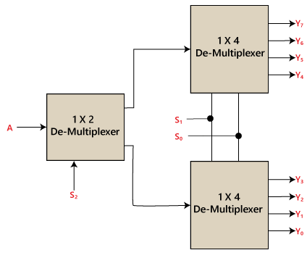
1×8 De-multiplexer using 1×4 and 1×2 De-multiplexer
Block Diagram:

Slide 24
1×16 De-multiplexer
In 1×16 de-multiplexer, there are total of 16 outputs, i.e., Y₀, Y₁, …, Y₁₆, 4 selection lines, i.e., S₀, S₁, S₂, and S₃ and single input, i.e., A. On the basis of the combination of inputs which are present at the selection lines S₀, S₁, and S₂, the input will be connected to one of these outputs.

Slide 25
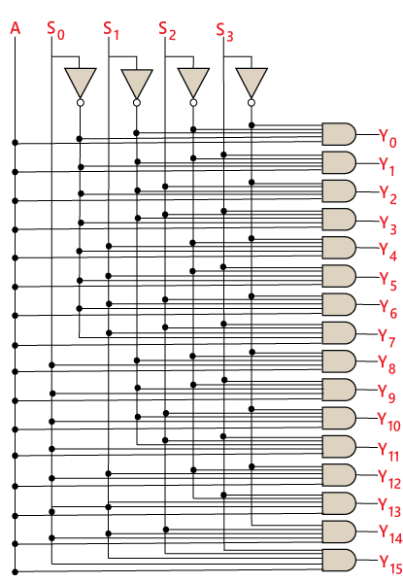
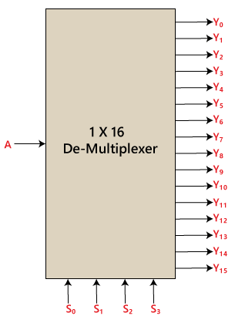
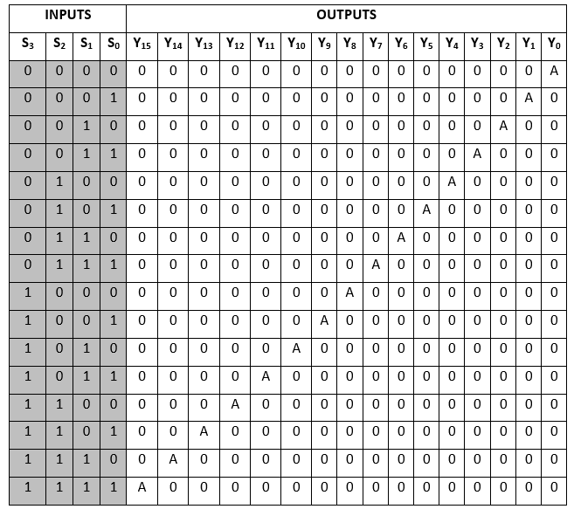
1×16 De-multiplexer
Logical circuit:
Block Diagram:
Truth Table:
The logical expression of the term Y is as follows:
Y₀=A.S₀'.S₁'.S₂'.S₃‘ Y₁=A.S₀'.S₁'.S₂'.S₃ Y₂=A.S₀'.S₁'.S₂.S₃‘ Y₃=A.S₀'.S₁'.S₂.S₃ Y₄=A.S₀'.S₁.S₂'.S₃‘ Y₅=A.S₀'.S₁.S₂'.S₃ Y₆=A.S₀'.S₁.S₂.S₃‘ Y₇=A.S₀'.S₁.S₂.S₃ Y₈=A.S₀.S₁'.S₂'.S₃‘ Y₉=A.S₀.S₁'.S₂'.S₃ Y₁₀=A.S₀.S₁'.S₂.S₃‘ Y₁₁=A.S₀.S₁'.S₂.S₃ Y₁₂=A.S₀.S₁.S₂'.S₃‘ Y₁₃=A.S₀.S₁.S₂'.S₃ Y₁₄=A.S₀.S₁.S₂.S₃‘ Y₁₅=A.S₀.S₁.S₂'.S₃

Slide 26
1×16 De-multiplexer using 1×8 and 1×2 De-multiplexer
We can implement the 1×16 de-multiplexer using a lower order de-multiplexer. To implement the 1×16 de-multiplexer, we need two 1×8 de-multiplexer and one 1×2 de-multiplexer. The 1×8 multiplexer has 3 selection lines, 1 input, and 8 outputs. The 1×2 de-multiplexer has only 1 selection line.
For getting 16 data outputs, we need two 1×8 de-multiplexer. The 1×8 de-multiplexer produces eight outputs. So, in order to get the final output, we need a 1×2 de-multiplexer to produce two outputs from a single input. Then we pass these outputs into both the de-multiplexer as an input.

Slide 27
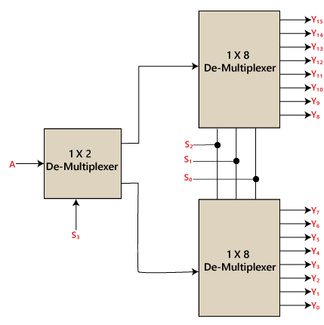
1×16 De-multiplexer using 1×8 and 1×2 De-multiplexer
Block Diagram:

Slide 28


